Slide 1
Forward Collision Accidents
The (Swiss) Insurance Company Perspective
4th February 2009, Accident Research, Bettina Sinzig

Slide 2
Agenda
Forward collision accidents
CEA study
P-safe group
AXA Winterthur figures
4th February 2009, Accident Research, Bettina Sinzig

Slide 3
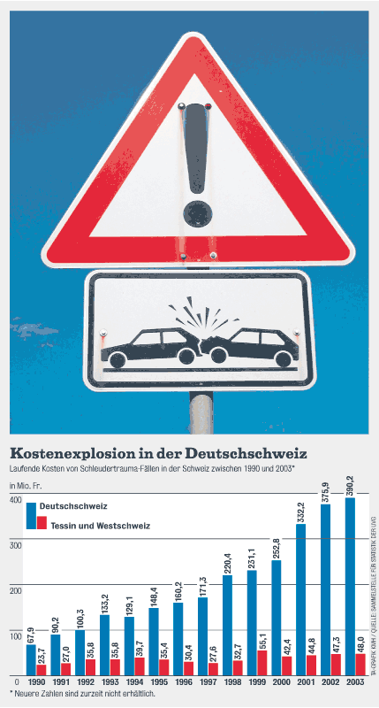
Forward collision accidents initial comments
Forward collision accidents are most often low speed accidents
Forward collision accidents lead in some cases to "whiplash"
In about 10% - 20% of initial whiplash cases, the healing process is not as expected and people are unable to work for the rest of their lives.
The diagram shows, that in the German speaking part of Switzerland the costs for whiplash in 2003 were more than four times higher than in 1990, whereas the costs in the French and Italian speaking parts only have doubled.
Forward collision accidents are – looking at costs – linked to the whiplash discussion, knowing that not only forward collision accidents lead to whiplash.
4th February 2009, Accident Research, Bettina Sinzig

Slide 4
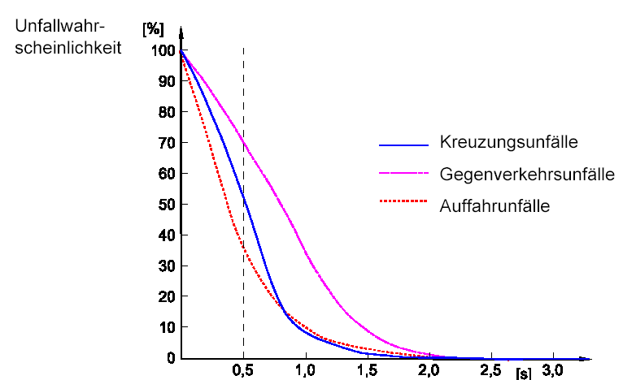
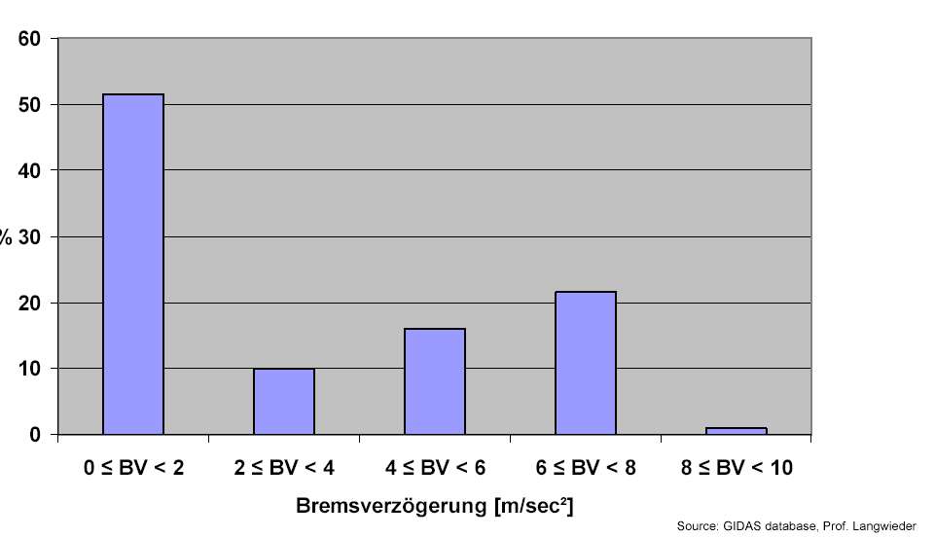
Pre crash phase and braking behaviour
Probability of having an accident
A study from Enke shows that compared to crossing accidents and accidents with oncoming traffic, rear end accidents (or forward collision accidents) have the highest potential for driver warning systems.
If people would react 0.5s earlier, more than 60% of the accidents could be prevented.
Crossing accidents
Acc. with oncoming tr.
Rear end accidents
Quelle: Enke
Earlier reaction of driver
A study from Langwieder, based on GIDAS, the German In-Depth Accident Study, analysed the braking behaviour before an accident happened. Result: more than 50% did not brake at all (0-2 m/s²).
4th February 2009, Accident Research, Bettina Sinzig

Slide 5
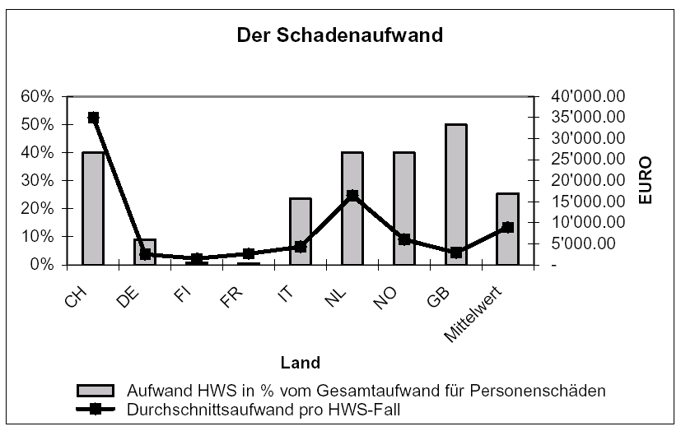
CEA Comparative Study 2004
Minor Cervical Trauma Claims
Cost of claims linked to cervical trauma
Average
Country
Costs for cervical trauma compared with the costs for all body injuries
Average cost per cervical trauma claim
4th February 2009, Accident Research, Bettina Sinzig

Slide 6
CEA study
Costs for cervical trauma vary a lot between countries
Costs per claim are highest in Switzerland
In Switzerland, Norway, Great Britain and the Netherlands about 40% to 50% of all costs for body injuries are spend for minor cervical trauma.
4th February 2009, Accident Research, Bettina Sinzig

Slide 7
p-safe group
RCAR – the Research Council for Automobile Repair consists of research centers which are paid by insurance companies.
The subgroup p-safe is interested in primary safety (advanced driver assistant systems) and its influence on the insurance industry.
p-safe focuses on the systems: ESC, LDW and CMBS (collision mitigation braking systems)
The most active members at the moment are:
  Thatcham, UK
  Folksam, S
  CESVIMAP and Centro Zaragoza, E
  GDV, D
  AXA Winterthur, CH
4th February 2009, Accident Research, Bettina Sinzig

Slide 8
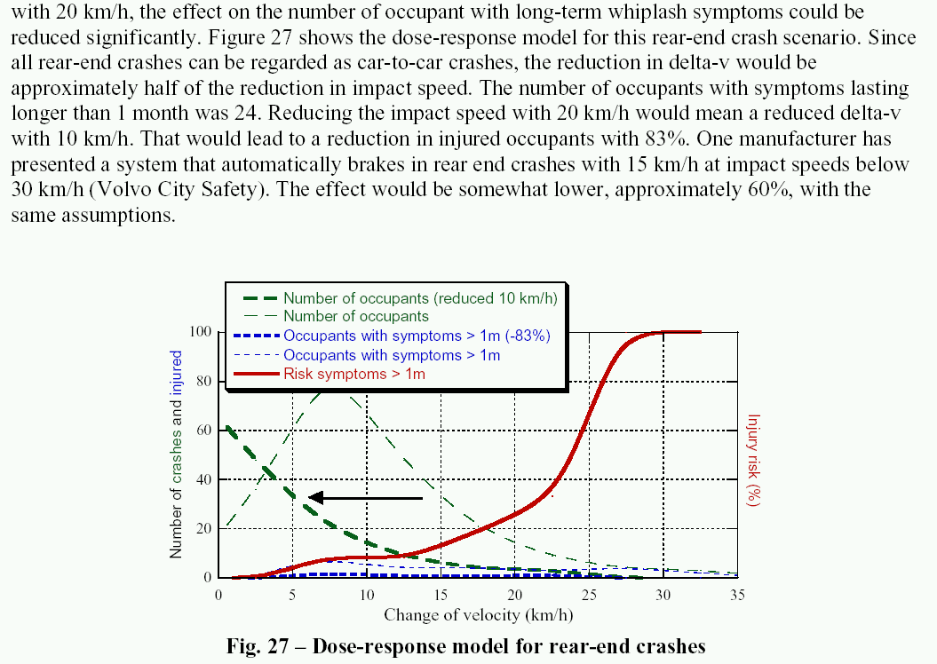
Results from Folksam
Source:
Bertil Aldman Memorial Lecture,
IRCOBI 2008
(DOSE-RESPONSE MODELS AND EDR DATA FOR ASSESSMENT OF
INJURY RISK AND EFFECTIVENESS OF SAFETY SYSTEMS,
Anders Kullgren)
4th February 2009, Accident Research, Bettina Sinzig

Slide 9
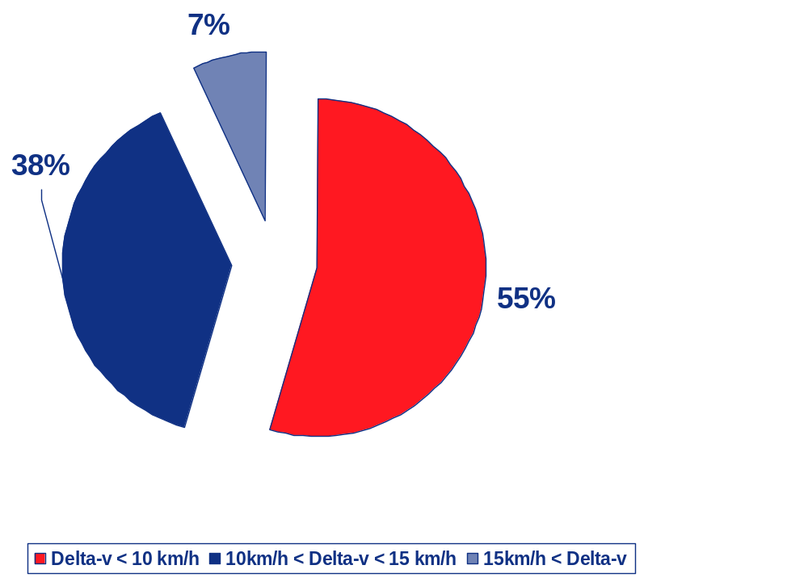
AXA Winterthur
Reconstructed accidents 2000-2004
Rear end accidents (forward collision accidents) are reconstructed if the damages to the car and the symptoms of the injured person are not consistent.
More than half of all cases are rear end accidents with a delta-v of less than 10 km/h!
Only 7% were not low speed accidents.
4th February 2009, Accident Research, Bettina Sinzig

Slide 10
Conclusion
A forward collision warning system will have a high potential in preventing rear end accidents.
Most often the cause of such accidents is inattention.
The potential in saving costs differs from country to country, or even from region to region.
AXA Winterthur is very interested in having a system which, ideally, warns the driver and brakes automatically, if the driver does not react.
4th February 2009, Accident Research, Bettina Sinzig

Slide 11

End Slide
Thank you
4th February 2009, Accident Research, Bettina Sinzig

